Slide 1
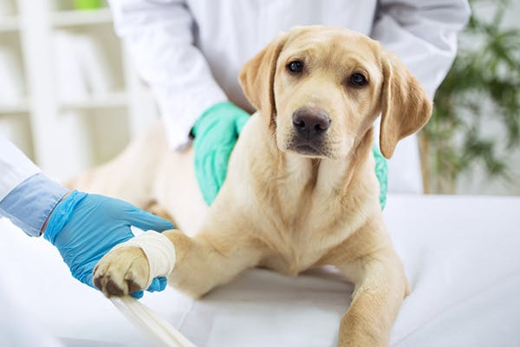
Hemorrage and hemostasis
Dr. Ashraff Abdulrazaq

Slide 2
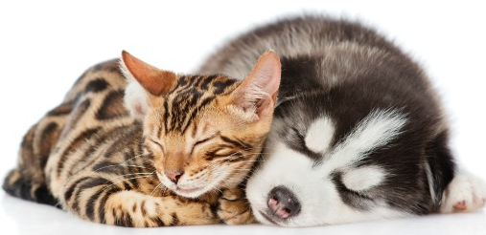
■ Loss of blood from the vascular system
■ Bleeding is eventually accompanied by
● shock
● and loss of red blood
● reduce the oxygen carrying
capacity of blood
Hemorrhage

Slide 3
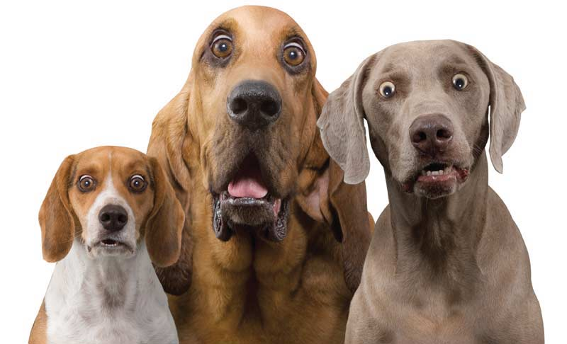
Causes
1- penetrating wound
2- Incisions (surgical incision)
3-Contusions or laceration
4- Blood may fail to clot within normal time because, Liver disease, irradiation, chemical poisoning

Slide 4
Classification
1-according to source
2-according to time of occurrence
3-according to extent

Slide 5
classification
According to source
Arterial hemorrhage
Blood is bright red, and flow under pressure
Venous hemorrhage
Blood is bluish-red and flow freely
Capillary hemorrhage
The blood oozes under very low pressure

Slide 6
According to time of occurrence as
Secondary hemorrhage
Occurs more than24 hours after initial injury, usually result of necrosis, ulceration, occur due to slip ligature
Primary hemorrhage
Occurs at the time of injury
Intermediate hemorrhage
Occurs within 24 hours of injury

Slide 7
classification
According to extent
Petechial hemorrhage
Small hemorrhagic areas within skin, serosa, mucosa
Deep hemorrhage
Which refers to extravasations into soft tissue.
Brushing hemorrhage
Which refers to larger areas of subcutaneous or submucosal hemorrhage

Slide 8
Hemostasis
■ A complex process that stops bleeding after injury to a blood vessel.
►The process of hemostasis can be divided into distinct stages namely:
1-primary hemostasis-- platelet plug formation
2-secondary hemostasis – coagulation cascade

Slide 9
hemostasis
► There are at least 3 factors involved in the spontaneous arrest of bleeding:
1●Extravascular
2● Vascular
3● Intravascular

Slide 10
Hemostasis
Extravascular:
Location of vessels, elastic nature of surrounding tissue, vessels passing through bone or cartalige are protected, vasoconstriction tend to reduce hemorrhage
Vascular:
When B.V injured the intima rolls inward and vessels end retract, provided suitable surface for accumulation of platelet and clot formation
Intravascular:
A series of blood clotting factors become activated when blood platelets undergo morphological changes in the presence of damaged endothelial tissue.

Slide 11
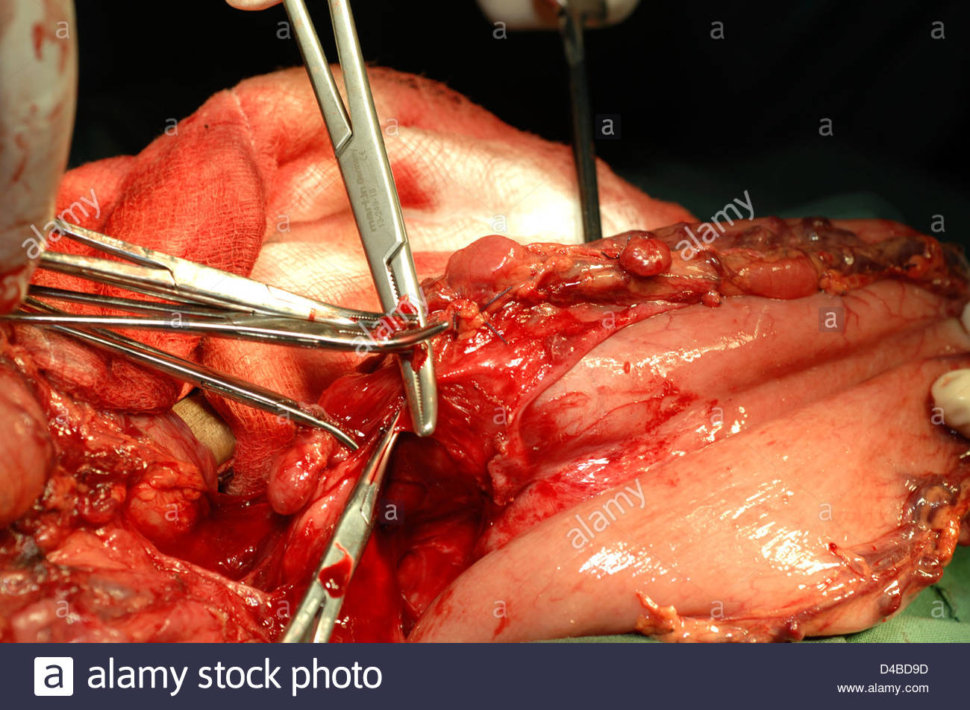
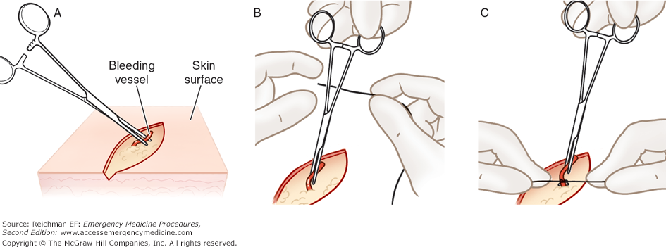
Mechanical arrest of haemorrhage
1-Crushing
2-Torsion: can be twisting vessels by artery forceps
3-Ligation: This involves tying the end of bleeding vessels to prevent further escape blood materials which used same which used in suture
4-Suturing: Although suturing is used primarily to appose wound edges

Slide 12
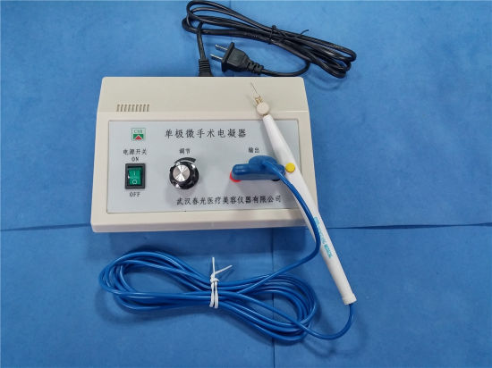
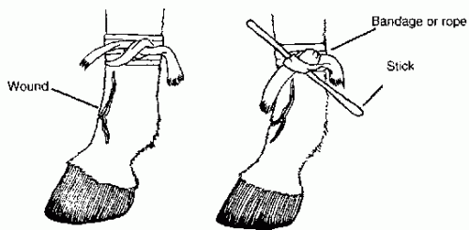
Mechanical arrest of haemorrhage
5- pressure: Bleeding from surgical incision can be stopped by pressing a gauze sponge against the bleeding point
6- Tourniquet: by constricting band , should used for short time, tourniquets should be released every 20 minute
7- Electrosurgery and Electrocoagulation, Thermocautery burns tissues, and the coagulated tissues act as hemostatic plug

Slide 13
Hemostasis with topically applied substances
Substance have an astringent effect on tissue and blood vessels, applied topically to small cut, example feeric sulfate, feeric chloride, glacial acetic acid, silver nitrate, alum, tannic acid
►Specific coagulant:
Gelfoam is a spongelike substance which a large surface on which blood will clot, topical thrompin is specific coagulant factor
► Systemic hemostatic agents:
Vit K is necessary for formation of prothrombin, and helpful in preventing excessive hemorrhage

